Slide 1
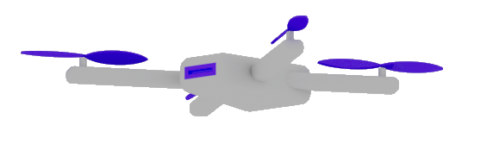

Best practices:
Building Enterprise
Applications
that leverage
GenAI
Dr. Damir Dobric
Lead Software Architect daenet GmbH / ACP Digital
Microsoft Regional Director,
Most Valuable Professional: AI

Slide 2

GenAI Unpacked:
BEYOND BASICS
Dr. Damir Dobric
Lead Software Architect daenet GmbH / ACP Digital
Microsoft Regional Director,
Most Valuable Professional: AI

Slide 3

ML vs. GenAI What is different and why it is important?
Traditional ML
Lot of Data
Long Training
GenAI
Pretrained
GPT=General Pretrained Transformer

Slide 4
AI Services
Open AI
https://platform.openai.com/docs/models
Azure AI Foundry https://oai.azure.com/portal/****/models https://ai.azure.com/

Slide 5
Working with TOKENS

Slide 6

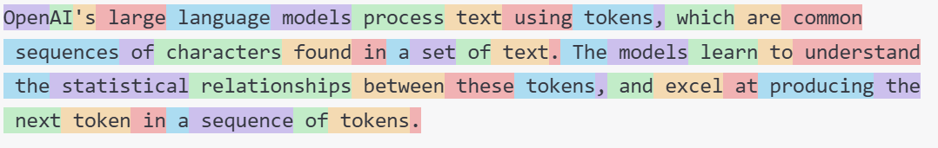
What are Tokens?
1 token ~= 4 chars in English
1 token ~= ¾ words
100 tokens ~= 75 words
Byte Pare Encoding (Gage,1994): Wikipedia
What are tokens and how to count them?
Token Pricing: Pricing - OpenAI API

Slide 7
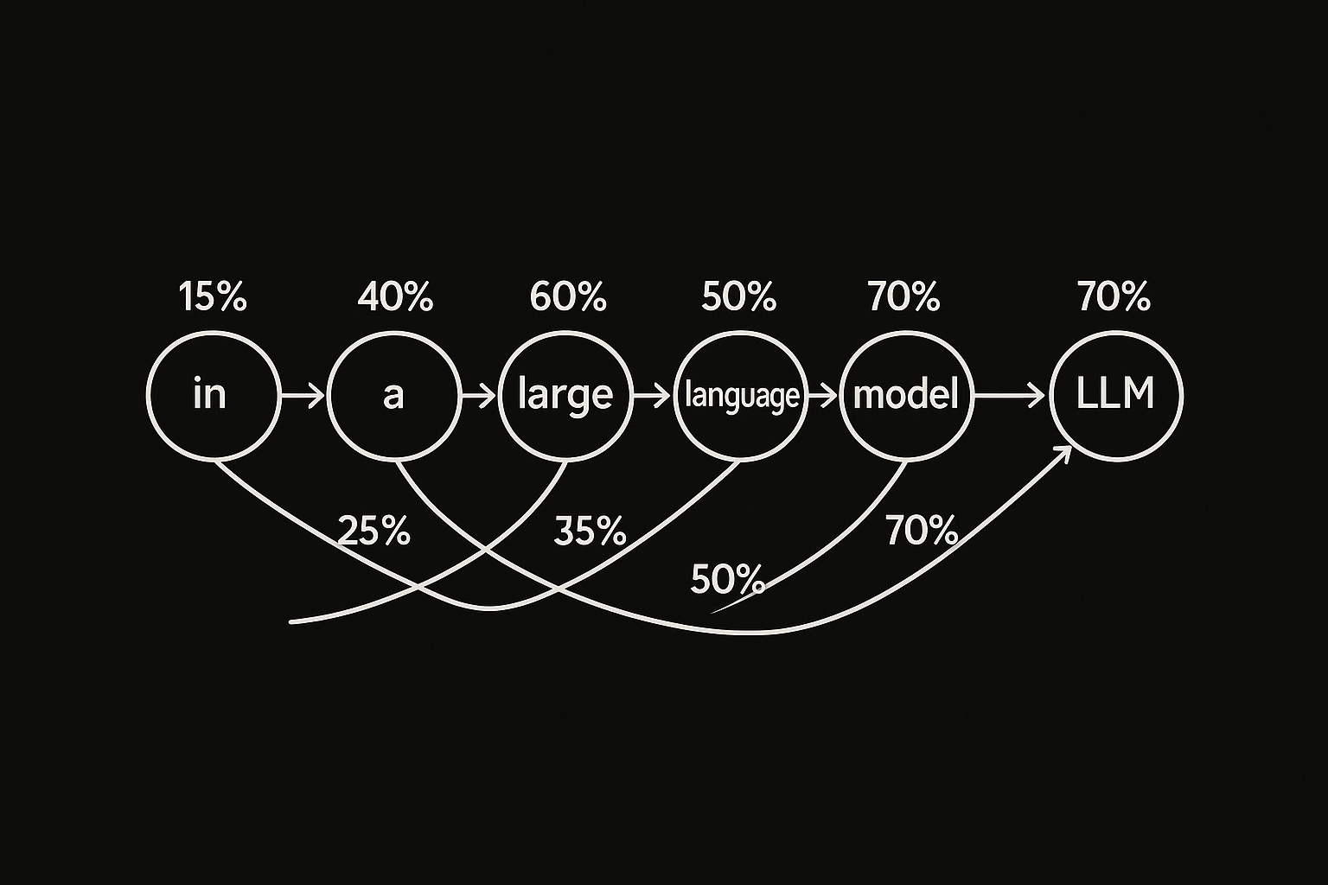
Transformer follows token probabilities

Slide 8



Token Costs
User: How are you? IN
(1)
AI
Prompt
(2)
Agent: I‘m fine, how can I help you. OUT

Slide 9
DEMO
Tokenizer
Creating tokens in C#

Slide 10
Working with EMBEDDINGS

Slide 11
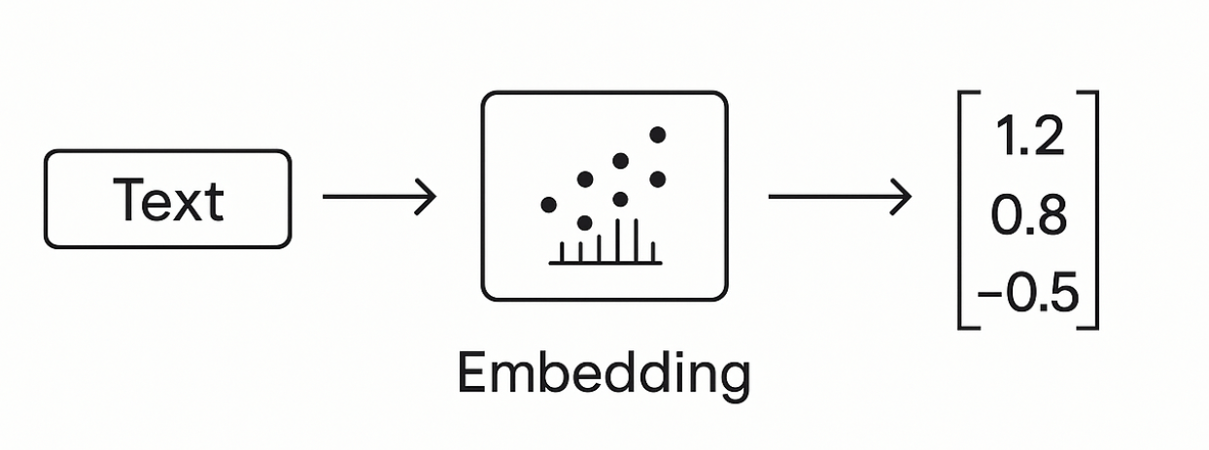
Embeddings
Making a vector from text

Slide 12

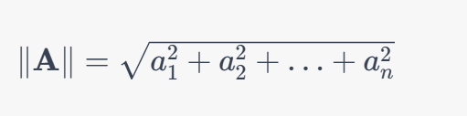
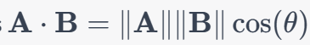
Similarity Between Multidimensional Vectors
Dot Product
The Norm
Cosine Similarity

Slide 13
Embeddings Use-Cases?
Semantic Search
Classification
Clustering
Recommendations
. . .

Slide 14
DEMO
Consuming Embedding Model with HTTP/Post
Creating Embeddings in C#
Classification Demo

Slide 15
VECTOR DATABASES

Slide 16
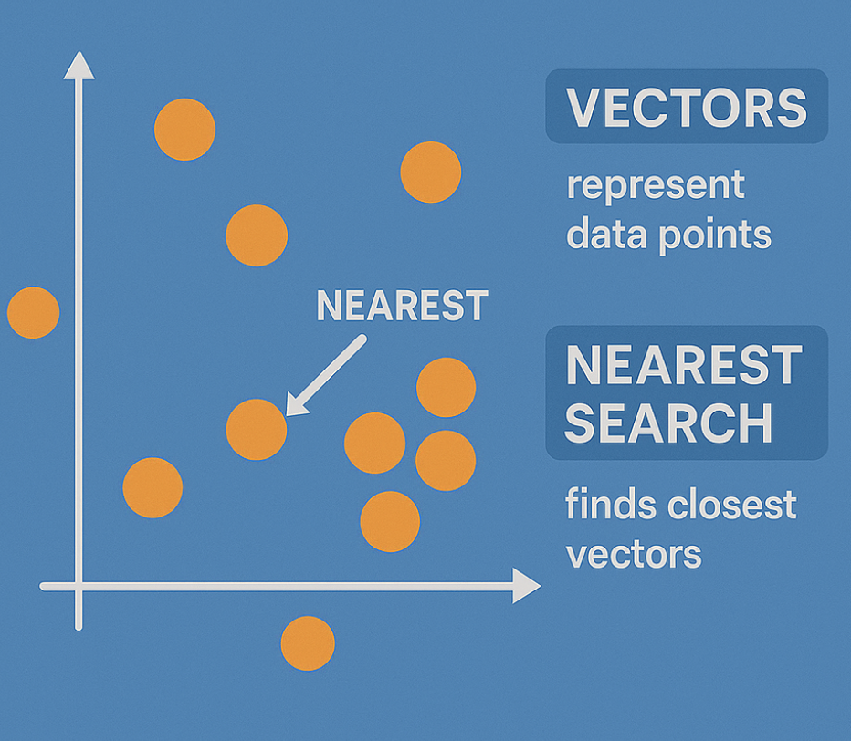
Embeddings in GraphDB

Slide 17
Vector DBs
SqlServer 2025 Native Vector Search
Quadrant
CosmosDB
…

Slide 18
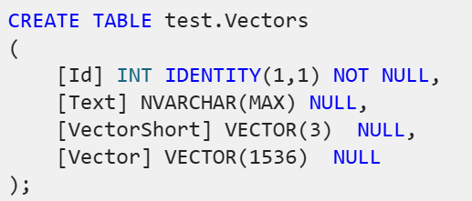
SqlServer 2025 Native Vector Search
SqlServer 2025 Native Vector Search
In Azure
On-Prem
SQL Server Native Vector Search for .NET Developers

Slide 19
DEMO
SQL Server Native Vector Search
SQL Server Native Vector
DECLARE @v1 VECTOR(2) = '[1,1]';
DECLARE @v2 VECTOR(2) = '[-1,-1]';
SELECT
VECTOR_DISTANCE('euclidean', @v1, @v2) AS euclidean,
VECTOR_DISTANCE('cosine', @v1, @v2) AS cosine,
VECTOR_DISTANCE('dot', @v1, @v2) AS negative_dot_product;

Slide 20
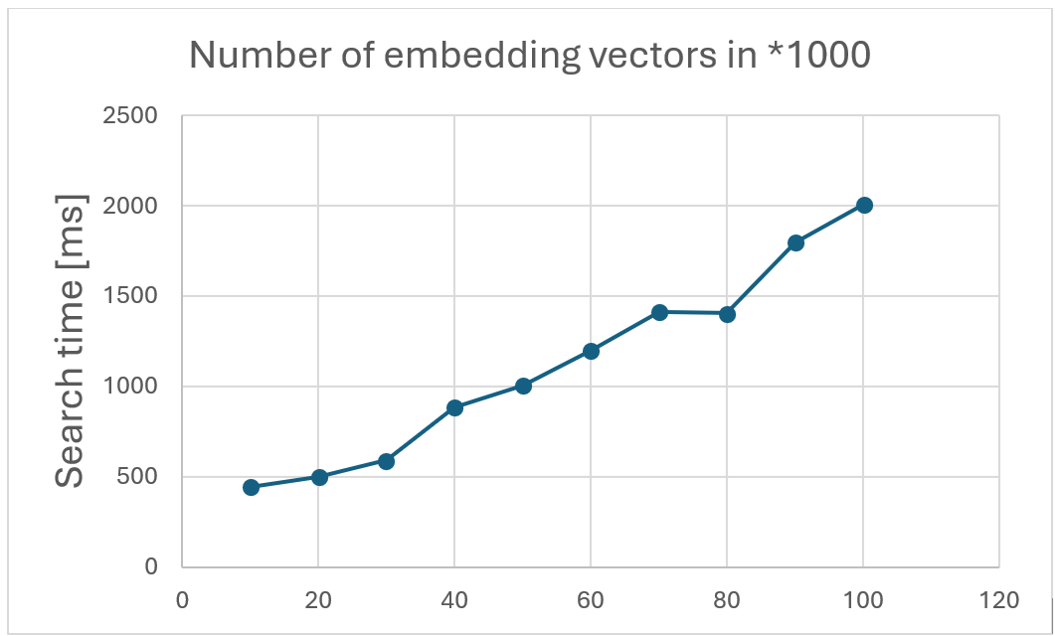
Keep in Mind!!

Slide 21
COMPLETION MODELS
How does all this work?

Slide 22
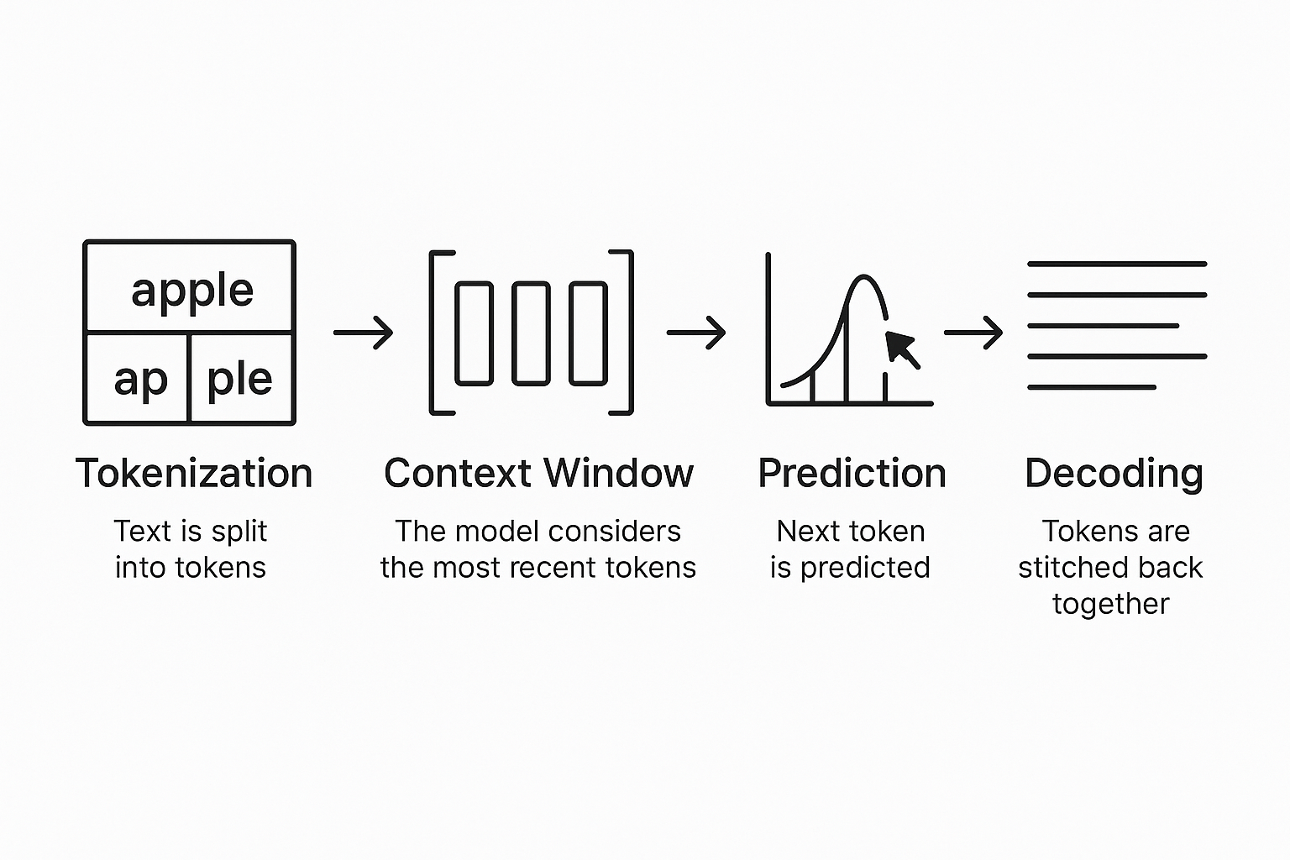
Completion Models
Text Completion Flow

Slide 23

DEMO
C# Application
Using OpenAI nuget package
Executing ChatCompletions
Presenting Probabilities

Slide 24
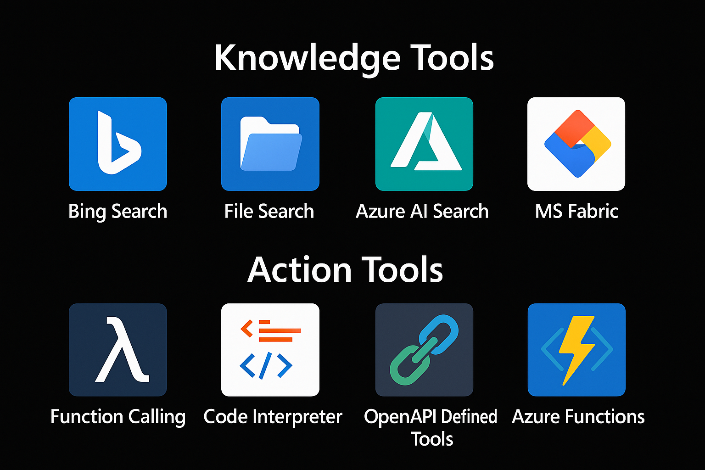

Extending Models
=> RAG
Tool 1
AGENT
=> Function Calling
Tool 2

Slide 25
RAG Retrieval Augmented Generation

Slide 26
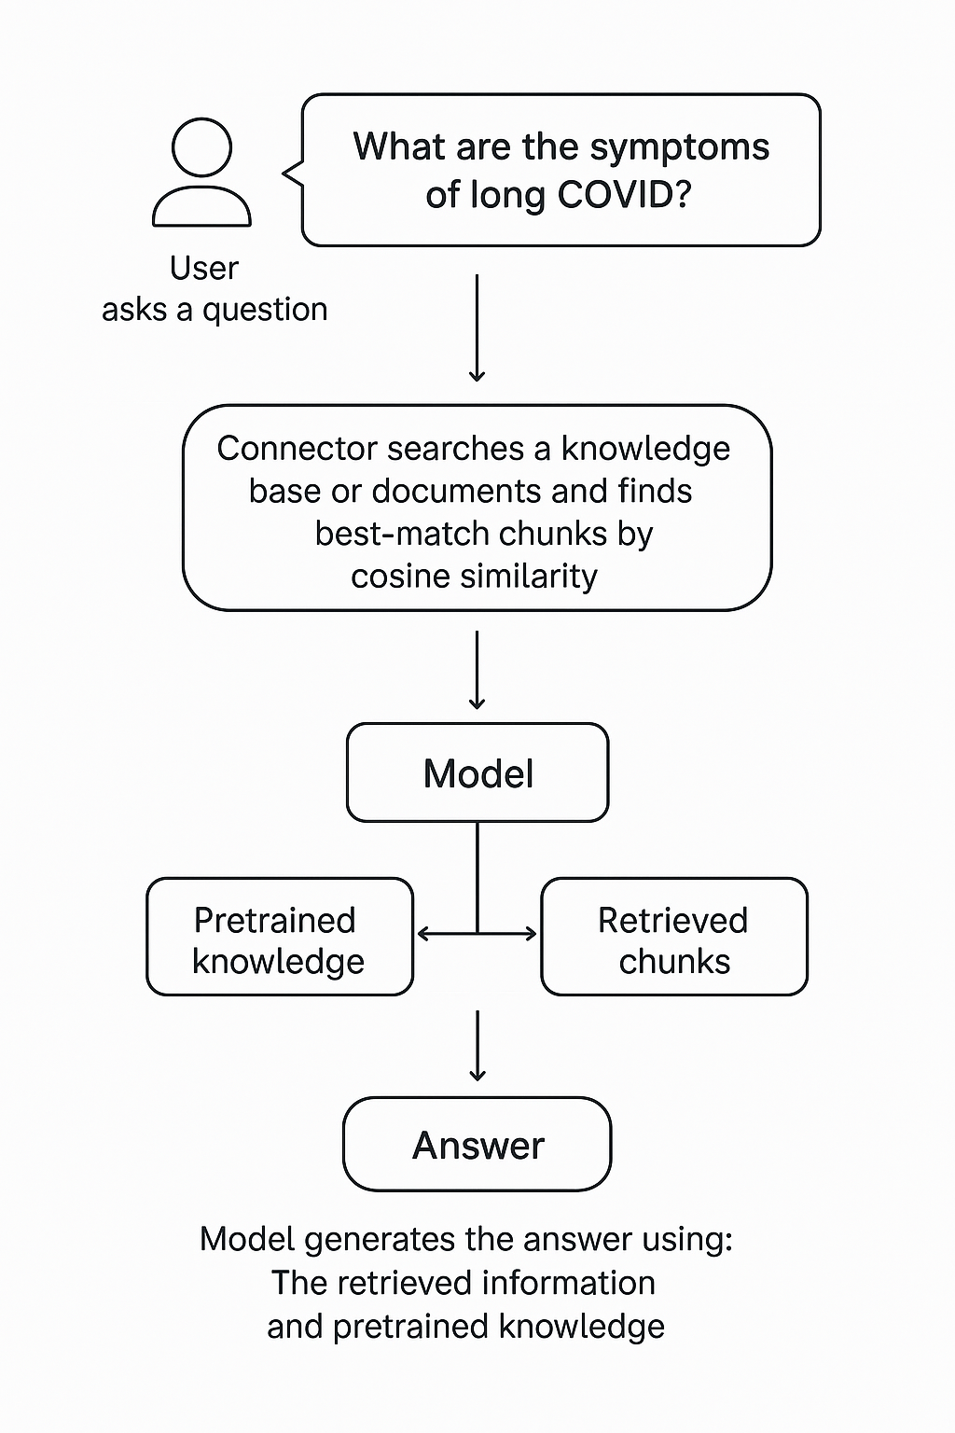
RAG Retrieval-Augmented Generation
Extending the model knowledge
Combines information retrieval with text generation
https://arxiv.org/abs/2005.11401

Slide 27
DEMO (c#)
Creating chunks
Creating embeddings
InMemory Vector DB
Calculating Similarity

Slide 28
Function Calling

Slide 29
Chat Model Interaction
User: How are you?
(1)
AI
Prompt
(2)
Agent: I‘m fine, how can I help you

Slide 30
Function Calling
{
"type": "function",
"function": {
"name": "get_weather",
"description": "Retrieves current weather for the given location.",
"strict": true,
"parameters": {
"type": "object",
"properties": {
"location": {
"type": "string",
"description": "City and country e.g. Bogotá, Colombia"
},
"units": {
"type": ["string", "null"],
"enum": ["celsius", "fahrenheit"],
"description": "Units the temperature will be returned in."
}
},
"required": ["location", "units"],
"additionalProperties": false
}
}
}

Slide 31

Function Calling
User: Switch on the light to green.
LichtPlugin
SwitchLightOn(color)
SwitychLightOff
(1)
WeatherPlugin
ShowInfo(Location)
AI
Prompt
(2)
My Database
Tool: SwitchLightOn(green)
Schritt 2:
KI ermittelt aus dem Prompt die passende Funktion und Argumente. Bsp.:
SchallteLichAn(grün)
Plugin Library
Enthält die Beschreibungen von Funktionen.

Slide 32
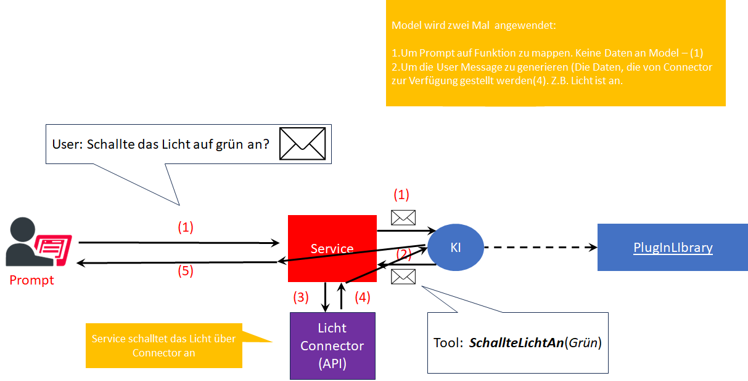
Function Calling
Schritt 2:
KI ermittelt aus dem Prompt die passende Funktion und Argumente. Bsp.:
SchallteLichAn(grün)
Plugin Library
Enthält die Beschreibungen von Funktionen.

Slide 33
DEMO (c#)
Function Calling with
SemanticKernel Plugin

Slide 34
A Scientific look under the hub

Slide 35
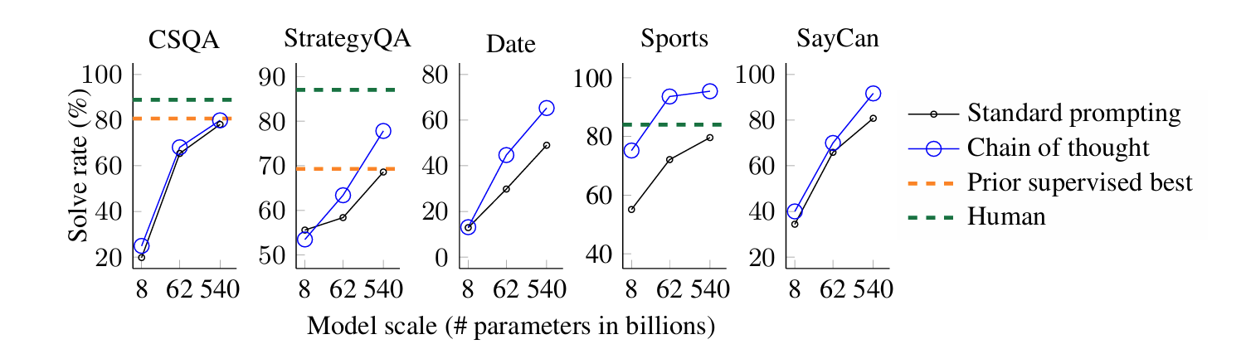
Chain of Tought
A prompting technique used to improve reasoning
Models think step by step before giving an answer.
Google Research, Brain Team
https://arxiv.org/abs/2201.11903

Slide 36
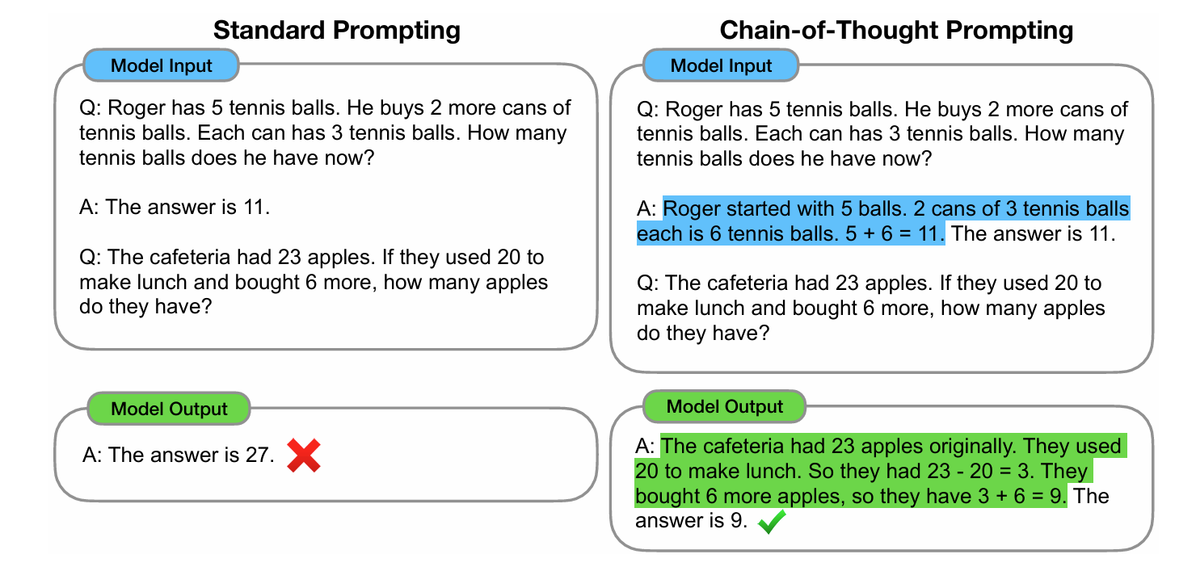
The Chain of Tought (CoT)

Slide 37
Reasoning
Common Models are
Outcome-Supervised Reward Models (ORM).
They use final answers
Reasoning Models
Receive Feedback on Each Step in Chain-of-Tought process
Process Reasoning Models (PRM)
https://cdn.openai.com/improving-mathematical-reasoning-with-process-supervision/Lets_Verify_Step_by_Step.pdf

Slide 38
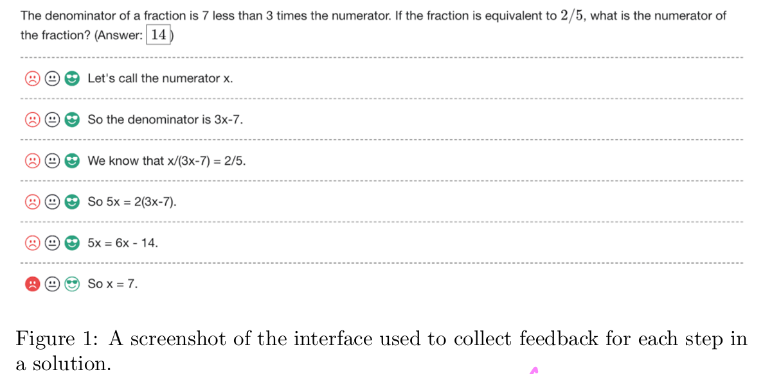
Human Supervised Learning

Slide 39
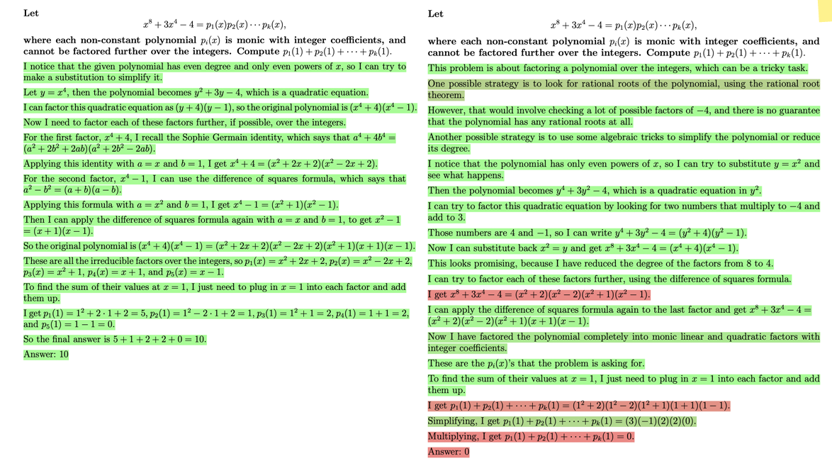

Slide 40
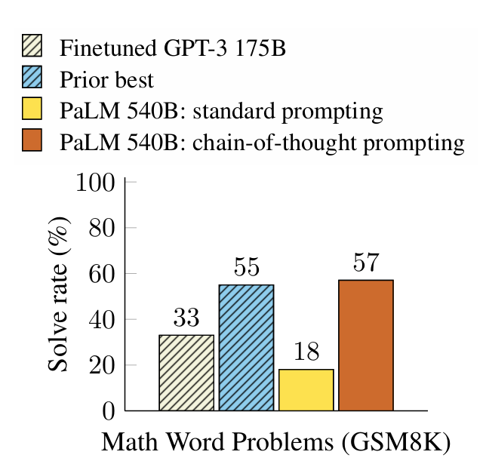
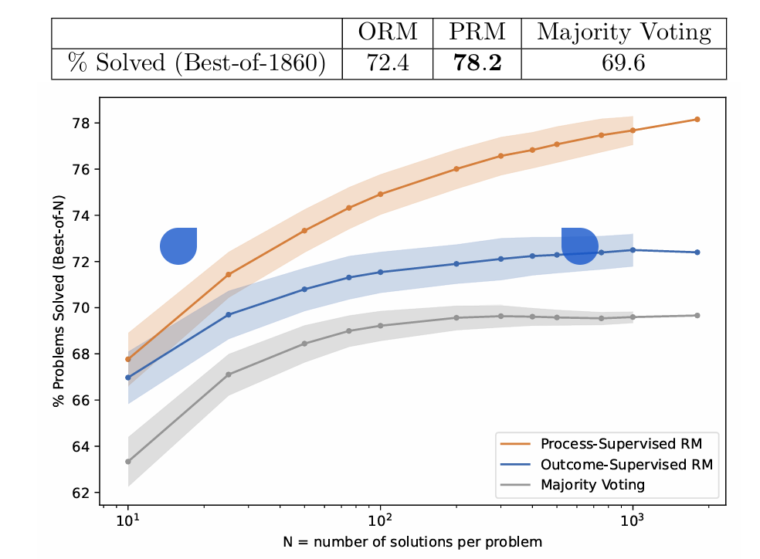
Comparison: CoT vs. PRM (Process Reasoning Models)
Hendrycks, C. Burns, S. Kadavath, A. Arora, S. Basart, E. Tang, D. Song, and J. Steinhardt. Measuring mathematical problem solving with the math dataset. arXiv preprint arXiv:2103.03874, 2021

Slide 41
Model Performance
LiveBench

Slide 42
Completions Chat Streaming TextToSpeech Look into the image Image Generation Image Edit Embeddings RunRetrievalAugmentedGenerationAsync();
OpenAI SDK

Slide 43
